Slide 1
Floating Point Representation
Demonstration of a float 3.64

Slide 2
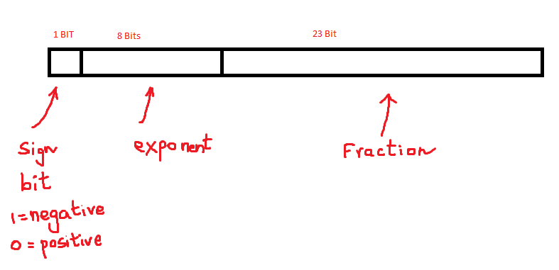

Slide 3
Exponent
8 bits exponent means we can have exponent from 0 to 255, 256 values.
Floating numbers can be Normalized form and De-Normalized form.
E = 0, we say the number is represented as De-Normalized form, F = 0.
E = 255, means Nan and +Infinity and –Infinity

Slide 4
Exponent – Normalized form
E has value from 1 to 254
To get to the actual exponent, you have to subtract -127. This will enable us to store exponents from : -126 to +127.
that is
What is stored in E | Actual exponent is
100 | 100 – 127 = -27
128 | 128 – 127 = 1
130 | 130 – 127 = 3
125 | 125 – 127 = -2
200 | 200 – 127 = 73
1 | 1 – 127 = -126
254 | 254 – 127 = 127

Slide 5
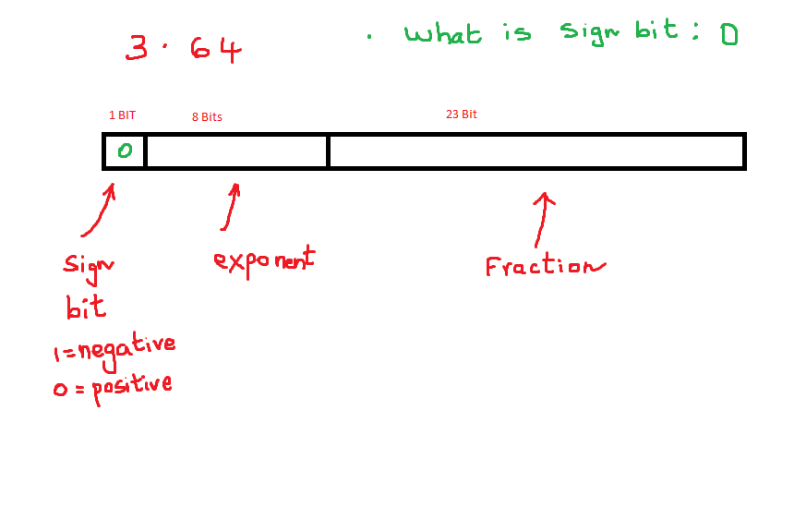

Slide 6
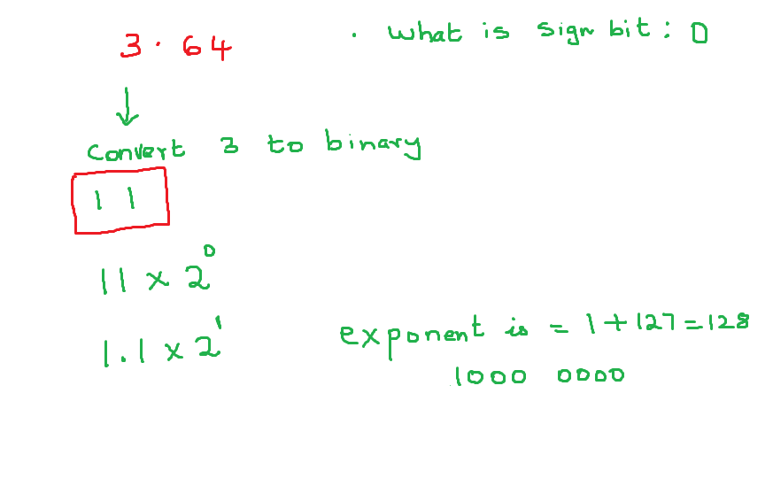

Slide 7
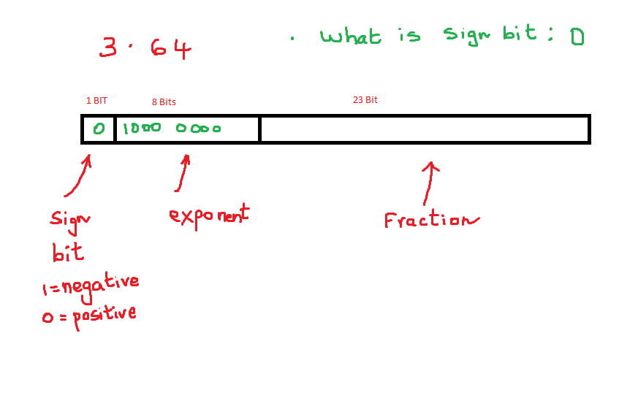

Slide 10
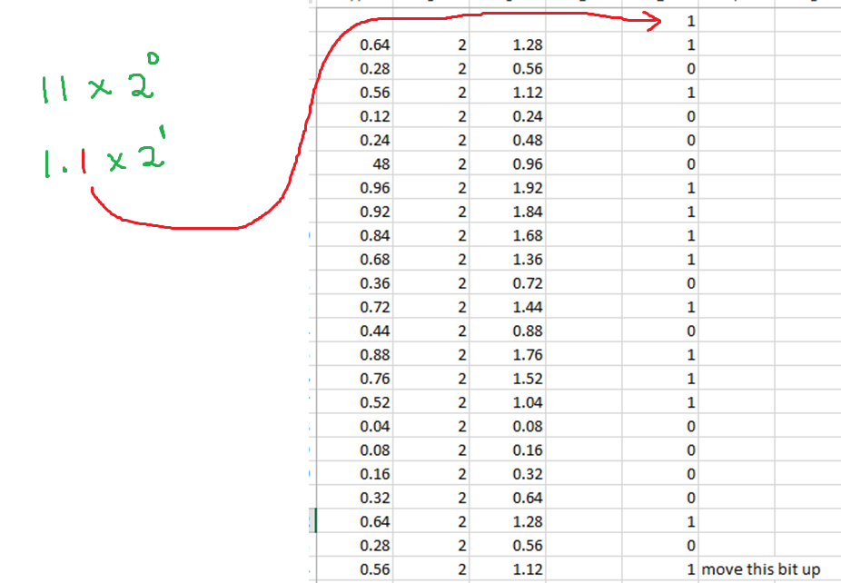

Slide 11
